Slide 1


Predicting Pokémon Battles
By
Alan Donahue
DSC 680 – Bellevue University
9 April 2023

Slide 2






History of Pokémon
Notes:
Satoshi Tajiri – created Pokemon in 1996
Pokemon Red and Blue – first video games and launch of franchise
Pokemon TCG
Ash Ketchum – Pokemon manga
Play! Pokemon – competitive eSports division of The Pokemon Company
Pokemon World Championships – pinnacle of competitive Pokemon eSports (money / prizes)

Slide 3
Assumptions and Limitations
Assumptions
No future changes to the game that would completely invalidate previous game knowledge
Custom algorithm closely simulates real Pokémon battles
Limitations
Only have 800 of the 1015 total Pokémon

Slide 4

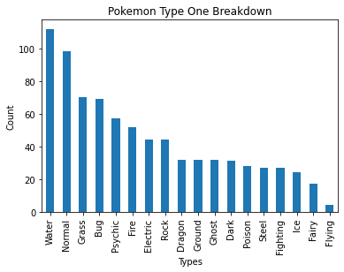
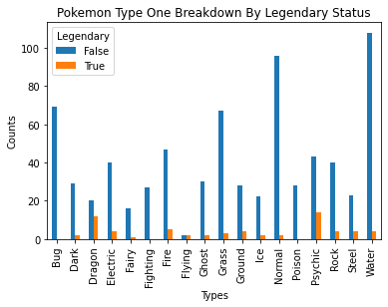
EDA Phase – Pokémon Characteristics
Column Name | Meaning
# | Each Pokémon has a unique ID. This column is the unique ID of each Pokémon
Name | Name of the Pokémon
Type 1 | Property of Pokémon that affects the power or strength and weaknesses of moves (e.g. Water). First type of a Pokémon
Type 2 | Secondary type of a Pokémon (optional)
HP | Hit Points. How healthy a Pokémon is
Attack | Stat of how powerful a Pokémon’s move will be
Defense | Stat of how well Pokémon can defend against attacks
Sp. Atk | Stat of how powerful a Pokémon’s special move will be
Sp. Def | Stat of how well a Pokémon can defend against special attacks
Speed | Stat which determines which Pokémon will attack first
Generation | Which generation a Pokémon is apart. Total of 8 Generations in the dataset
Legendary | Whether or not a Pokémon is a Legendary Pokémon which are usually more powerful
Primeape
Notes:
Pokemon Characteristics
12 columns

Slide 5
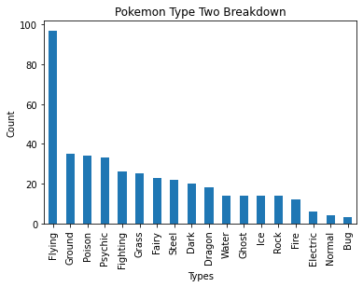
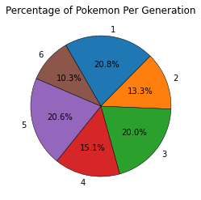
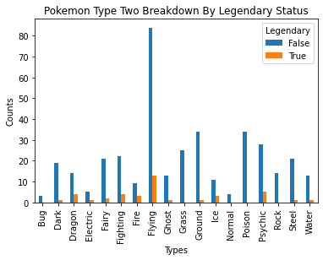
EDA Phase – Pokémon Characteristics

Slide 6

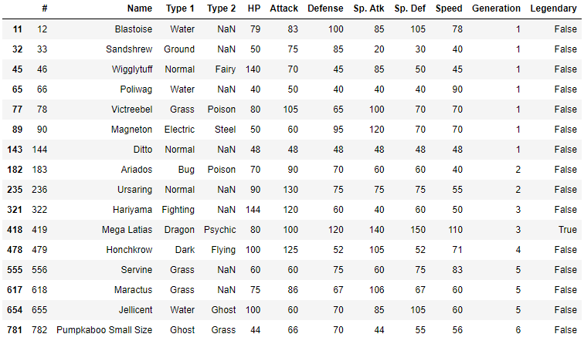
EDA Phase – Recorded Battles
Shuckle – Pokémon with only loses
Pokémon without recorded battles

Slide 7
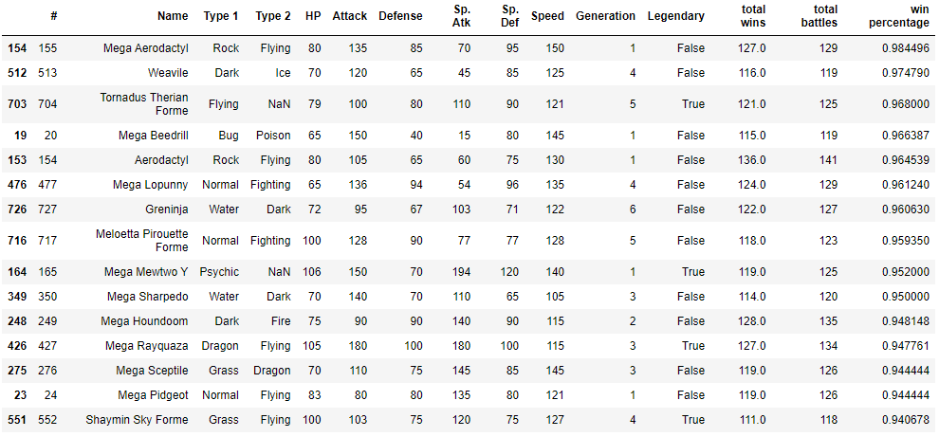

EDA Phase – Recorded Battles
Mega Aerodactyl
Top 15 Pokémon By Wins

Slide 8
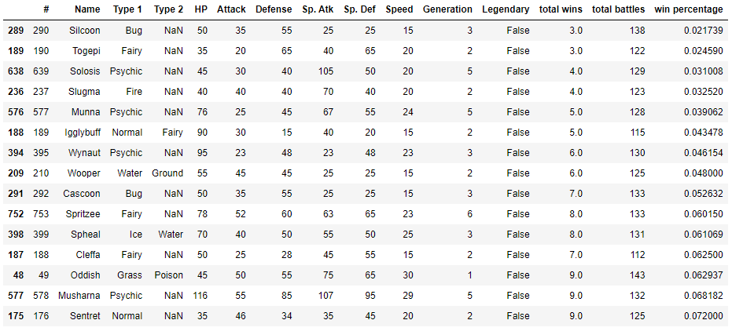

EDA Phase – Recorded Battles
Silcoon
Bottom 15 Pokémon By Wins

Slide 9
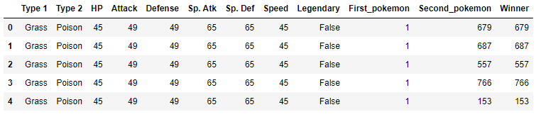
Preprocessing The Data
Merged Dataset

Slide 10
Models
Model | R2 Score
Linear Regression | .5137
Random Forest | .6921
XGBoost | .7159

Slide 11
Way Forward
Find real battle data to train the model with
Test the model out with a few professional players
Implement model through a website
Expand model to other aspects of competitive Pokémon

